Slide 1

Patent investigation
Schuyler Marin, Krissy Santucci,
Cody Sellers

Slide 2
Patents Filed in the United States in the last 20 years:
Who is submitting
Where are they from
What are they
inventing

Slide 3
Why we’re asking….
We were wondering if the boom in technological advancement in our society would reflect in the types of patents being granted.

Slide 4

Hypothesis and Questions to Answer
Hypothesis
Questions
Companies/Government/Individuals from the United States would make up the majority of the granted patents.
There will be an increase of computer technology patents after the year 2000.
Companies will make up the majority of the assignee types.
Which companies filed the most patents?
Which countries filed for patents in the US?
How has the category of patent types changed over time?
What type of patent types are the most filed?

Slide 5
Data Gathering from:
Api
https://developer.uspto.gov/api

Slide 6
API Constraints & Considerations
Example URL: https://www.patentsview.org/api/patents/query?q={"_and":[{"_gte":{"patent_date":"2000-01-01"}},{"_lte":{"patent_date":"2000-03-31"}}]}&f=["patent_id","patent_year","assignee_organization","assignee_city","assignee_country","assignee_type", "nber_category_title", "nber_subcategory_title"]&o={"page":1,"per_page":25}
Quotes are required in the parameters… yuck
Maximum of 100,000 items per call
Maximum of 10,000 items per “page”

Slide 7



Exploration and Cleaning Data
Clean-Up
Exporting to CSV
Creating and Merging data sets
Groupby

Slide 8
Total patents
Year #of Patents
2000 176192
2001 184172
2002 184494
2003 190865
2004 181413
2005 157829
2006 196489
2007 182978
2008 188726
2009 192052
2010 244599
2011 248101
2012 277285
2013 303658
2014 334079
2015 326969
2016 334674
2017 352587
2018 341104
2019 300386
Tracked for the last 20 years

Slide 9
Patent Trends Over Time

Slide 10
Assignee type US AND FOREIGN
COMPANY
INDIVIDUAL
GOVERNMENT

Slide 11
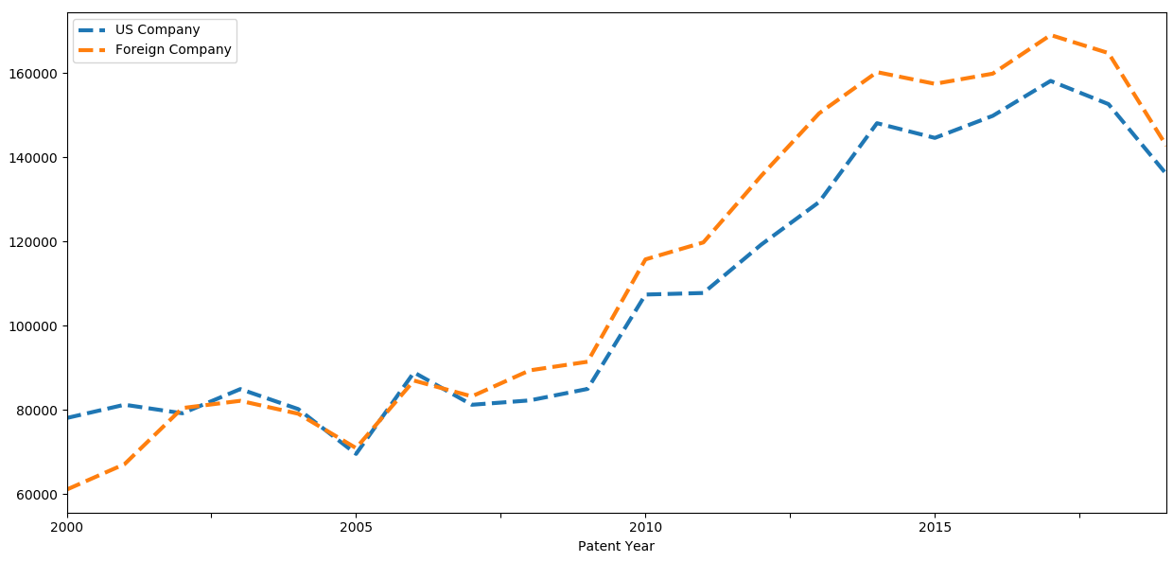
U.S. Companies vs. Foreign Companies
US and Foreign company patterns seem to be following a similar pattern in regards to patent counts for the last 20 years.

Slide 12
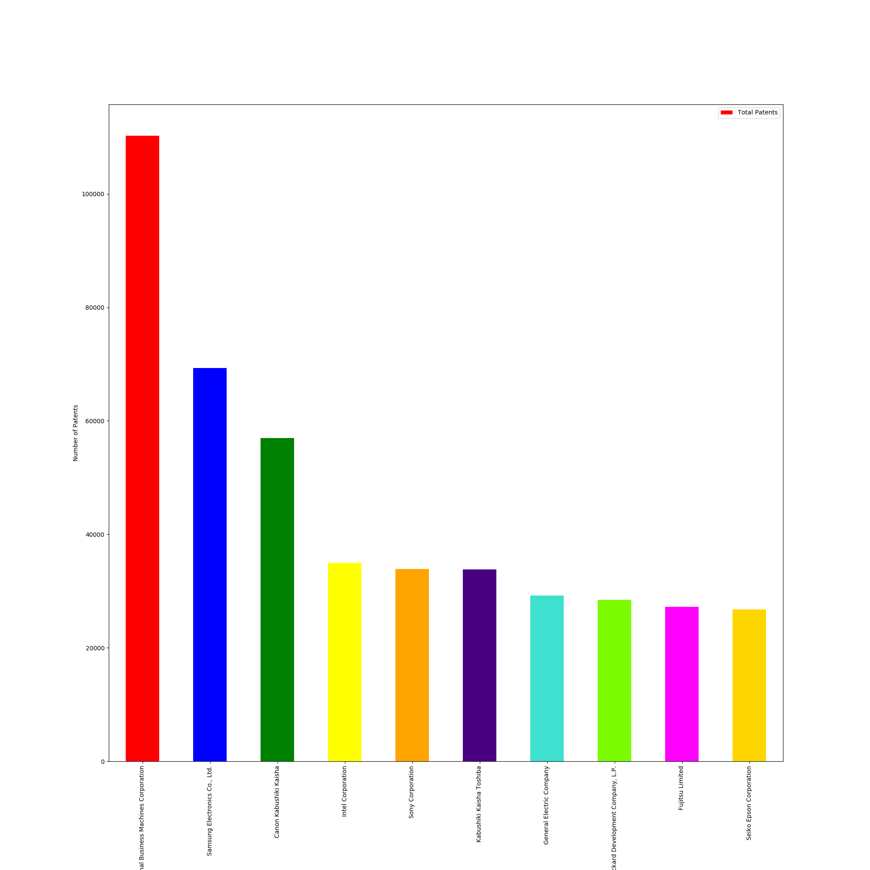
Top 10 Companies
International Business Machines Corporation 110266
Samsung Electronics Co., Ltd. 69310
Canon Kabushiki Kaisha 56945
Intel Corporation 35001
Sony Corporation 33864
Kabushiki Kaisha Toshiba 33810
General Electric Company 29205
Hewlett-Packard Development Company, L.P. 28440
Fujitsu Limited 27237
Seiko Epson Corporation 26768

Slide 13
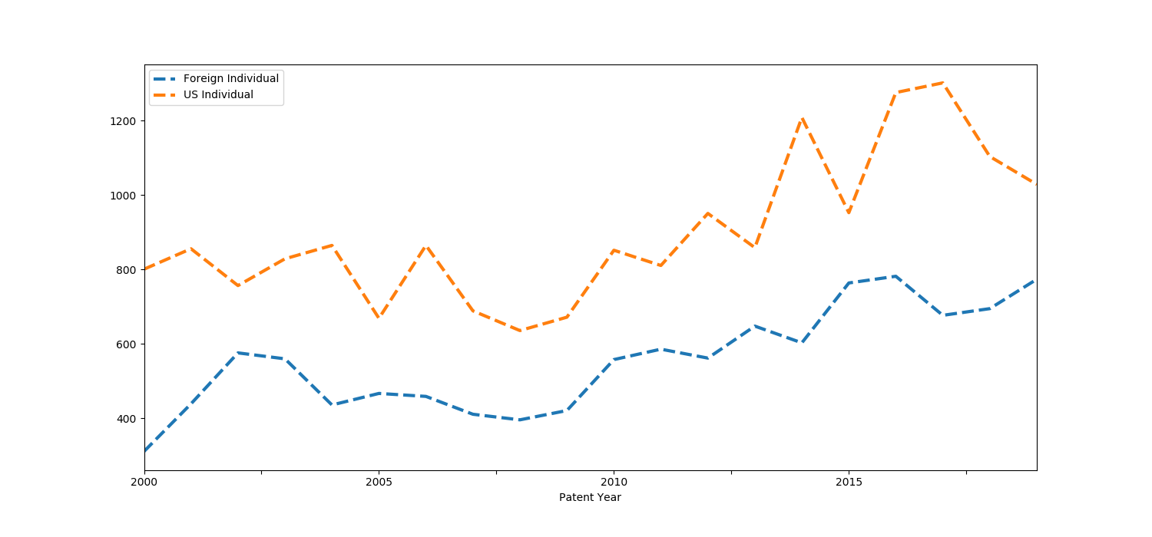
US Individuals vs. Foreign Individuals
US individuals file more patents than foreign
Both are following the similar trends over time.

Slide 14
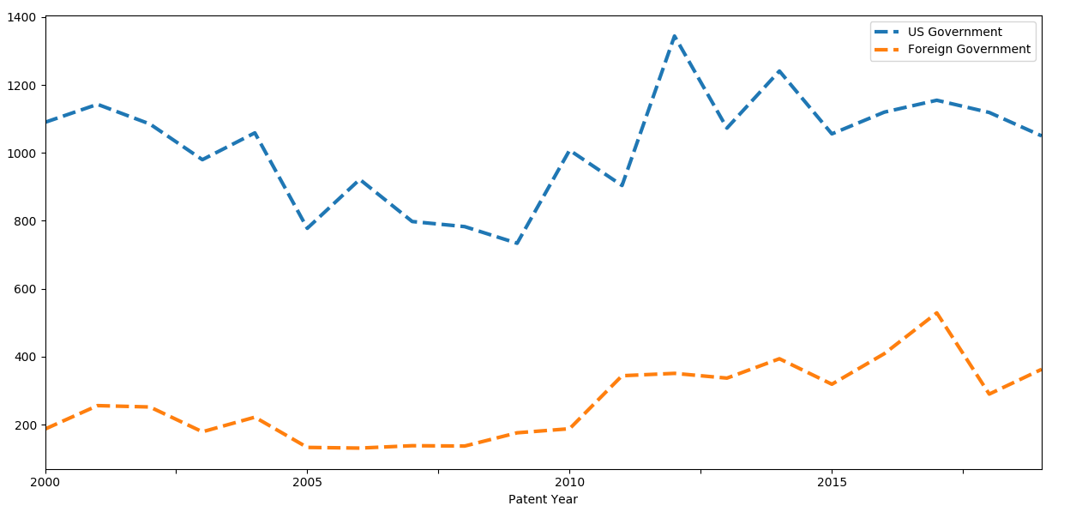
US Government vs. Foreign Governments
The United States Government files more patents than foreign

Slide 15
Patent categories

Slide 16
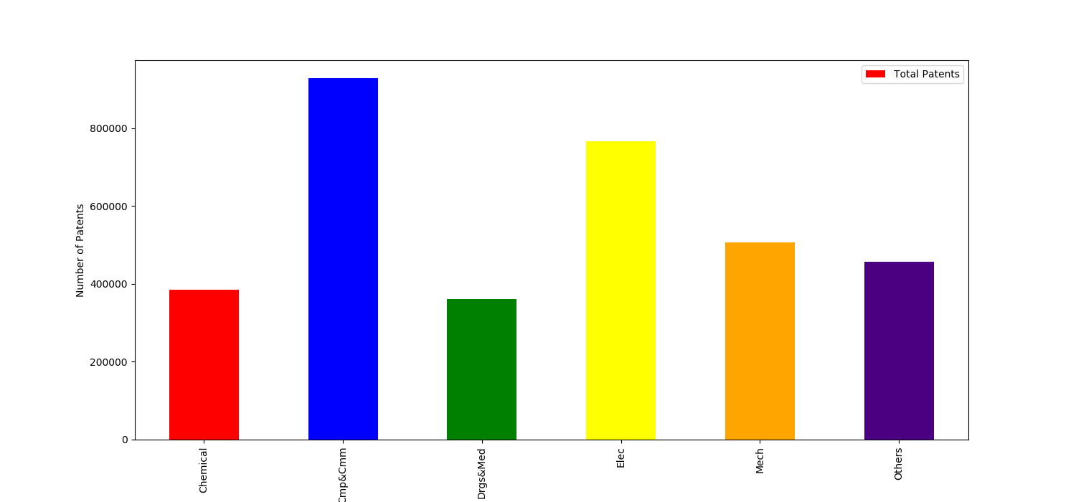
Category Distribution of Patents
Chemical
Computers/Communication
Drugs and Medical
Electrical
Mechanical
Other

Slide 17
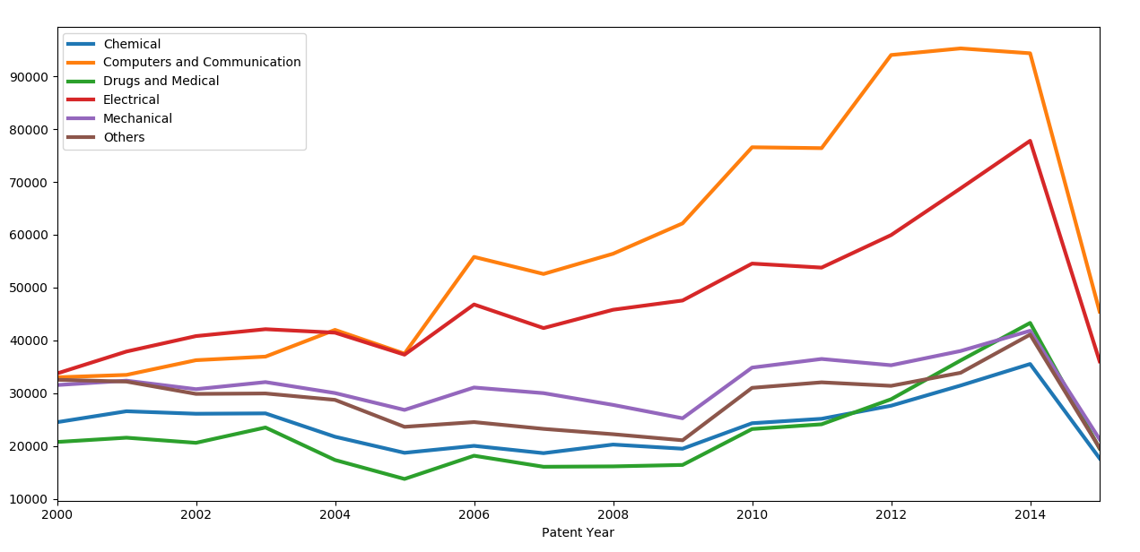
Categories Over Time

Slide 18
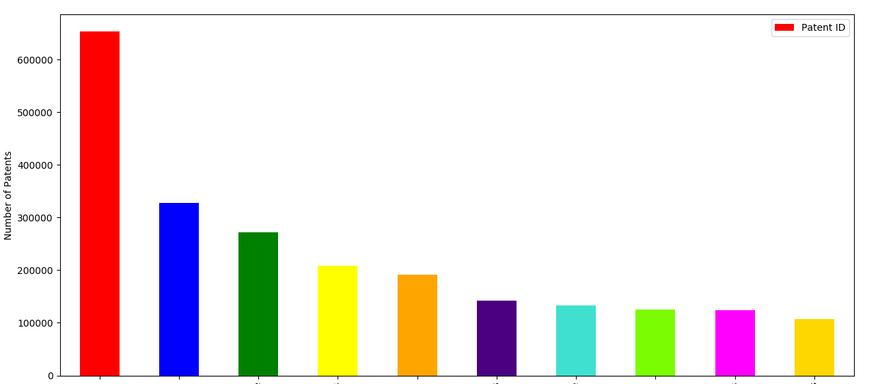
Sub-Category Distribution
Miscellaneous
Communications
Computer Hardware & Software
Semiconductor Devices
Drugs
Power Systems
Info Storage
Surgical & Medical Instruments
Computer Peripherals
Electrical Devices

Slide 19
Location of origin

Slide 20
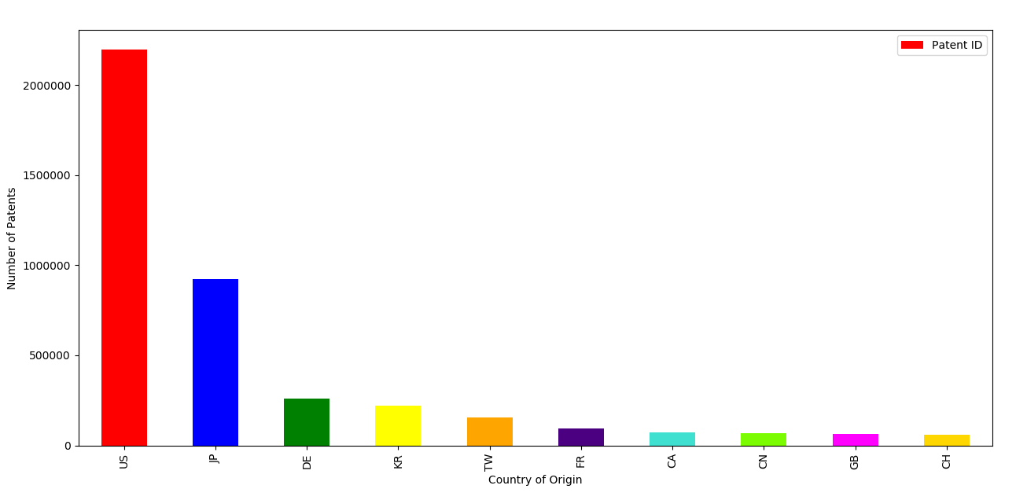
Country of Origin Distribution of Patents
US
JP
DE
KR
TW
FR
CA
CN
GB
CH

Slide 21
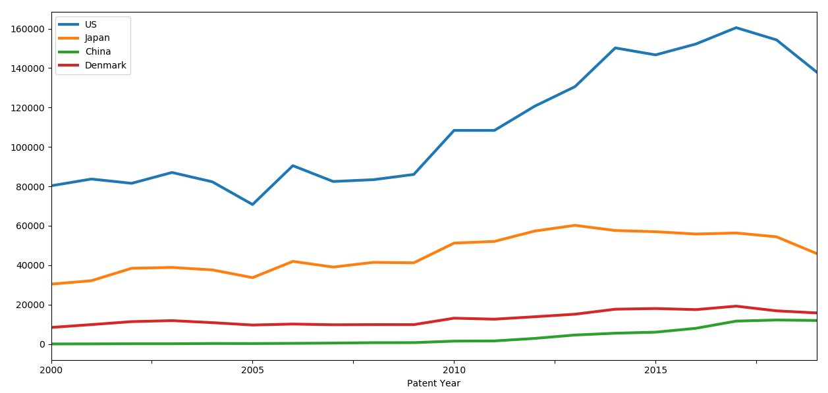
Country of Origin Over Time

Slide 22
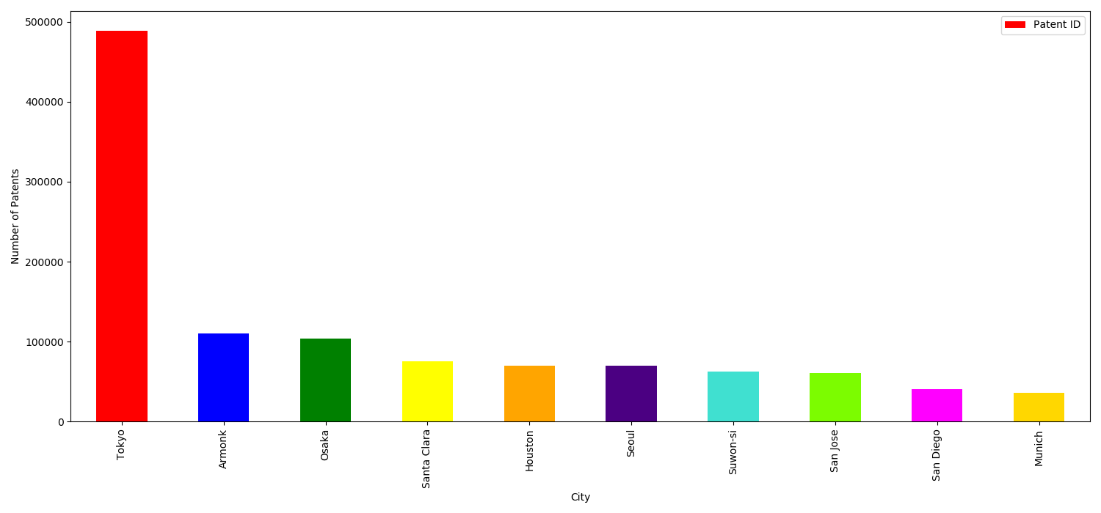
City Distribution of Patents
Tokyo
Armonk
Osaka
Santa Clara
Houston
Seoul
Suwon-si
San Jose
San Diego
Munich

Slide 23
Some findings

Slide 24
Patents Filed in the United States in the last 20 years are increasing.
Top company:
ibm
Country: United states and japan
Computer and
communication patents
Top city:
Tokyo

